Slide 1

MSiA 401 Predictive Analytics-I
Chapter 5: Multiple Linear Regression: Shrinkage and Dimension Reduction Methods
Ajit C. Tamhane

Slide 2
Methods to Address Multicollineariy
Shrinkage Estimation
Ridge Regression
Lasso Regression
Dimension Reduction Methods
Principal Components Regression
Partial Least Squares

Slide 3
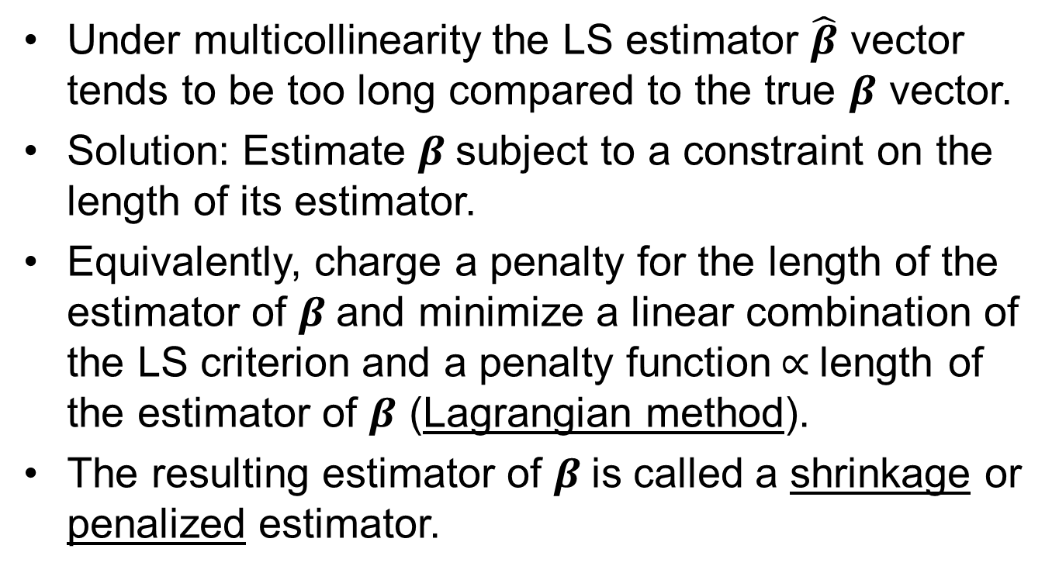
Why Shrinkage Estimation?
Under multicollinearity the LS estimator $\hat{β}$ vector tends to be too long compared to the true $β$ vector.
Solution: Estimate $β$subject to a constraint on the length of its estimator.
Equivalently, charge a penalty for the length of the estimator of $β$and minimize a linear combination of the LS criterion and a penalty function$∝$length of the estimator of $β$ (Lagrangian method).
The resulting estimator of $β$is called a shrinkage or penalized estimator.

Slide 4
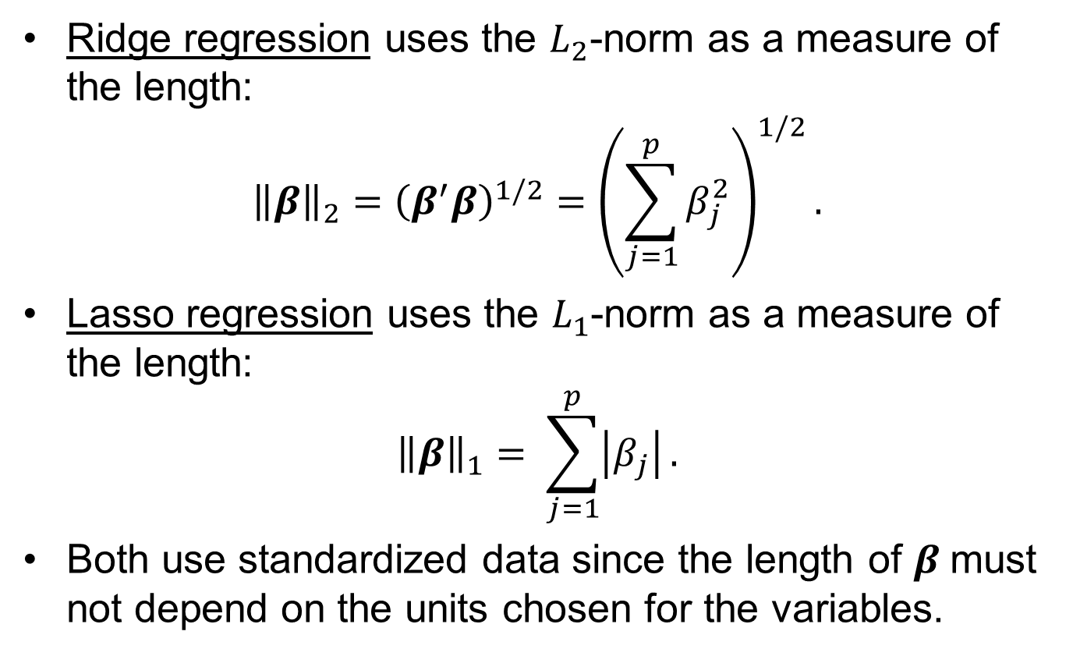
Norms Used by Ridge and Lasso Regression
Ridge regression uses the $L_{2}$-norm as a measure of the length:
$${\left\|β\right\|}_{2}={\left(β^{′}β\right)}^{1/2}={\left.\left(\sum_{j=1}^{p}{β_{j}^{2}}\right.\right)}^{1/2}.$$
Lasso regression uses the $L_{1}$-norm as a measure of the length:
$${\left\|β\right\|}_{1}= \sum_{j=1}^{p}{\left|β_{j}\right|}.$$
Both use standardized data since the length of $β$must not depend on the units chosen for the variables.

Slide 5
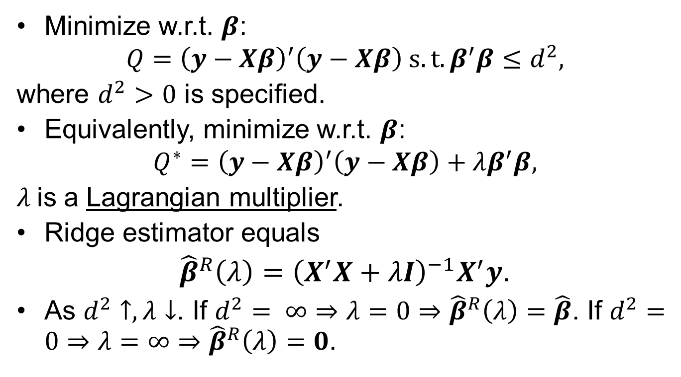
Ridge Regression
Minimize w.r.t. $β$:
$$Q={\left(y−Xβ\right)}^{′}\left(y−Xβ\right) s.t. β^{′}β≤d^{2},$$
where $d^{2}>0$ is specified.
Equivalently, minimize w.r.t. $β$:
$$Q^{∗}={\left(y−Xβ\right)}^{′}\left(y−Xβ\right)+λβ^{′}β,$$
$λ$is a Lagrangian multiplier.
Ridge estimator equals
${\hat{β}}^{R}\left(λ\right)={\left(X^{′}X+λI\right)}^{−1}X^{′}y$.
As $d^{2}↑, λ↓$. If $d^{2}= ∞⇒λ=0⇒{\hat{β}}^{R}\left(λ\right)=\hat{β}$. If $d^{2}=0⇒λ=∞⇒{\hat{β}}^{R}\left(λ\right)=0$.

Slide 6
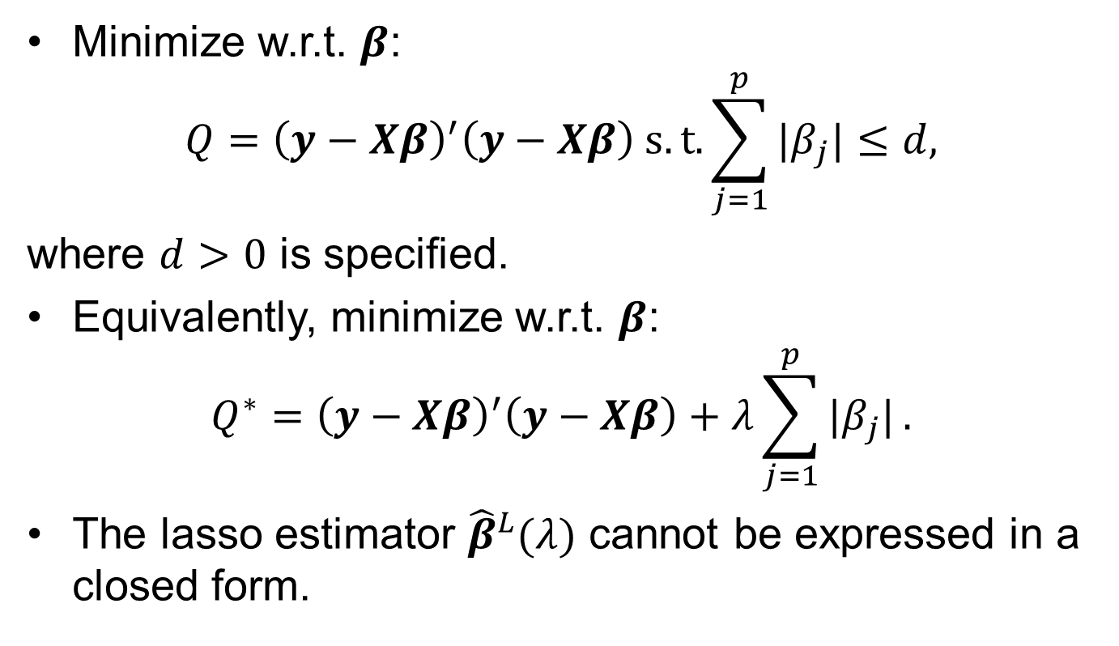
Lasso Regression
Minimize w.r.t. $β$:
$$Q={\left(y−Xβ\right)}^{′}\left(y−Xβ\right) s.t. \sum_{j=1}^{p}{|β_{j}|}≤d,$$
where $d>0$ is specified.
Equivalently, minimize w.r.t. $β$:
$$Q^{∗}={\left(y−Xβ\right)}^{′}\left(y−Xβ\right)+λ\sum_{j=1}^{p}{|β_{j}|}.$$
The lasso estimator ${\hat{β}}^{L}(λ)$ cannot be expressed in a closed form.

Slide 7
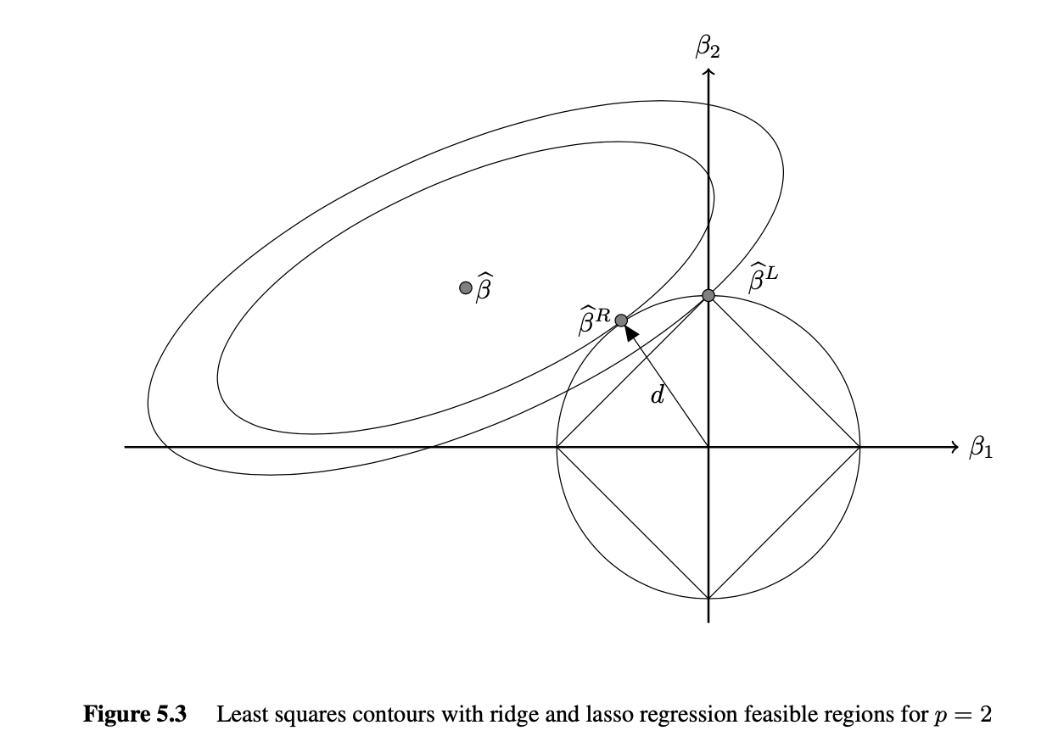
Geometric Interpretation of Ridge and Lasso Estimators

Slide 8
Comparison Between Ridge and Lasso Estimators
Ridge estimator touches a smooth hypersphere while the lasso estimator touches polyhedron at a corner or an edge or a face.
Hence ridge estimator shrinks all coefficients smoothly while lasso estimator sets some regression coefficients equal to zero effectively dropping those variables.
Therefore lasso regression can be used for variable selection, especially useful in sparse regression.

Slide 9
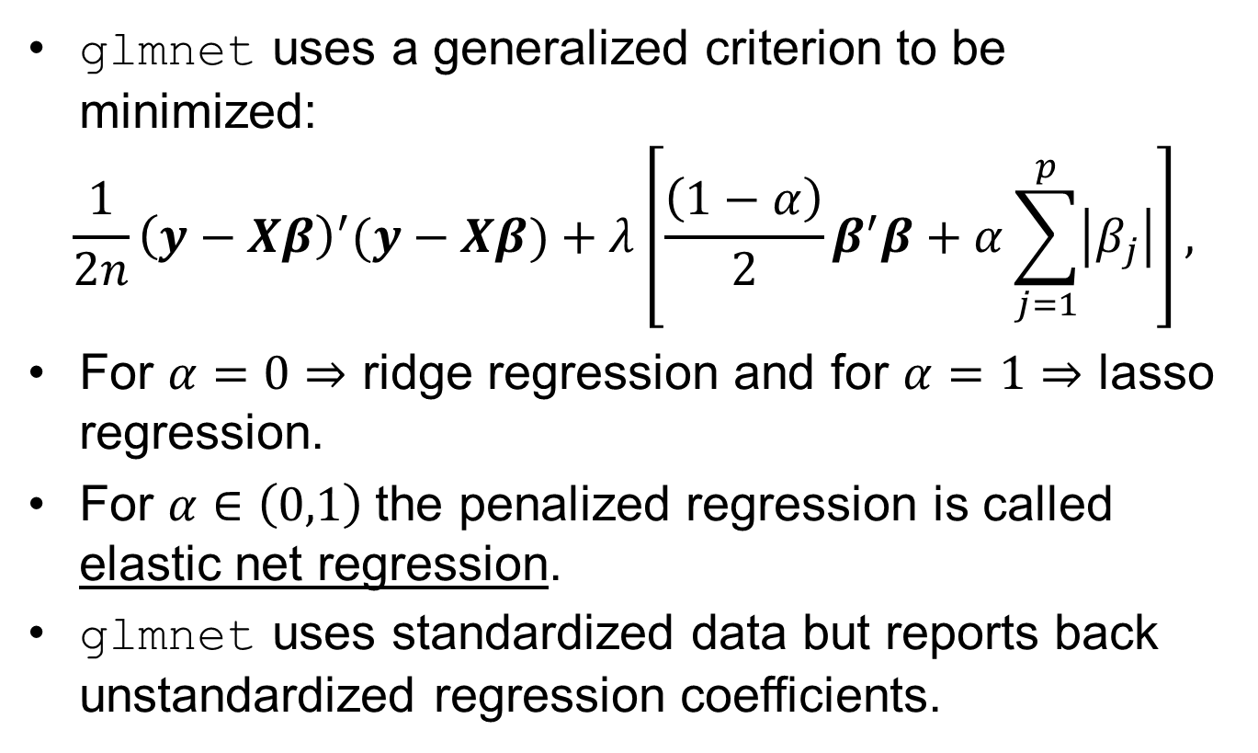
glmnet Package
glmnet uses a generalized criterion to be minimized:
$$\frac{1}{2n}{\left(y−Xβ\right)}^{′}(y−Xβ)+λ\left[\frac{\left(1−α\right)}{2}β^{′}β+α\sum_{j=1}^{p}{\left|β_{j}\right|}\right],$$
For $α=0⇒$ ridge regression and for $α=1⇒$ lasso regression.
For $α∈\left(0,1\right)$the penalized regression is called elastic net regression.
glmnet uses standardized data but reports back unstandardized regression coefficients.

Slide 10
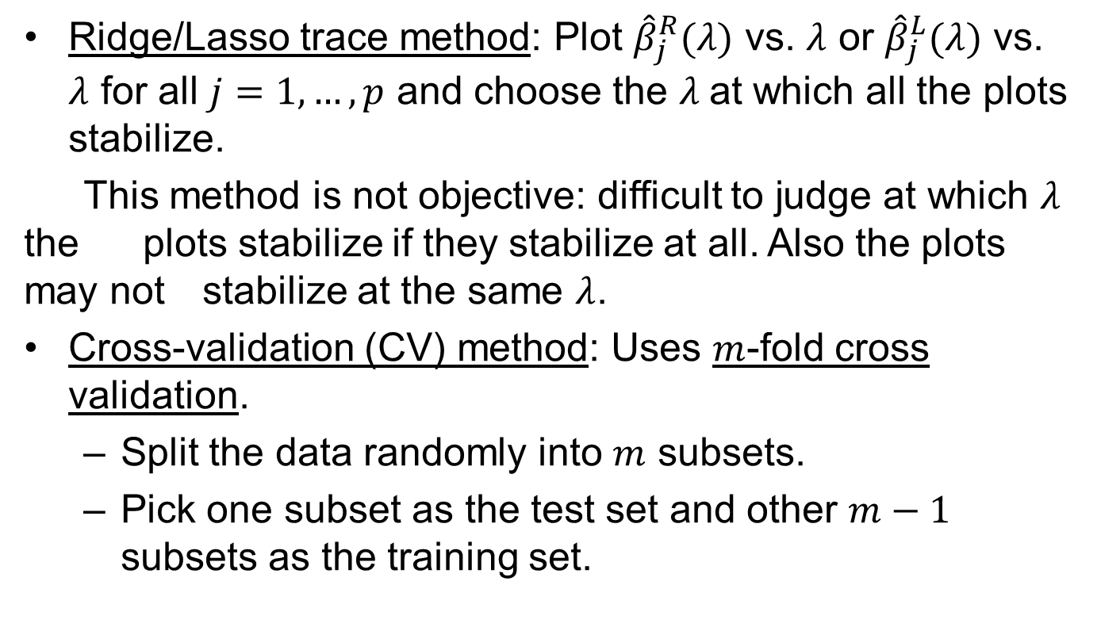

Choice of the Tuning Parameter $λ$
Ridge/Lasso trace method: Plot ${\hat{β}}_{j}^{R}(λ)$ vs. $λ$ or ${\hat{β}}_{j}^{L}(λ)$ vs. $λ$ for all $j=1,…,p$ and choose the $λ$at which all the plots stabilize.
This method is not objective: difficult to judge at which $λ$ the plots stabilize if they stabilize at all. Also the plots may not stabilize at the same $λ$.
Cross-validation (CV) method: Uses $m$-fold cross validation.
Split the data randomly into $m$ subsets.
Pick one subset as the test set and other $m−1$ subsets as the training set.

Slide 11
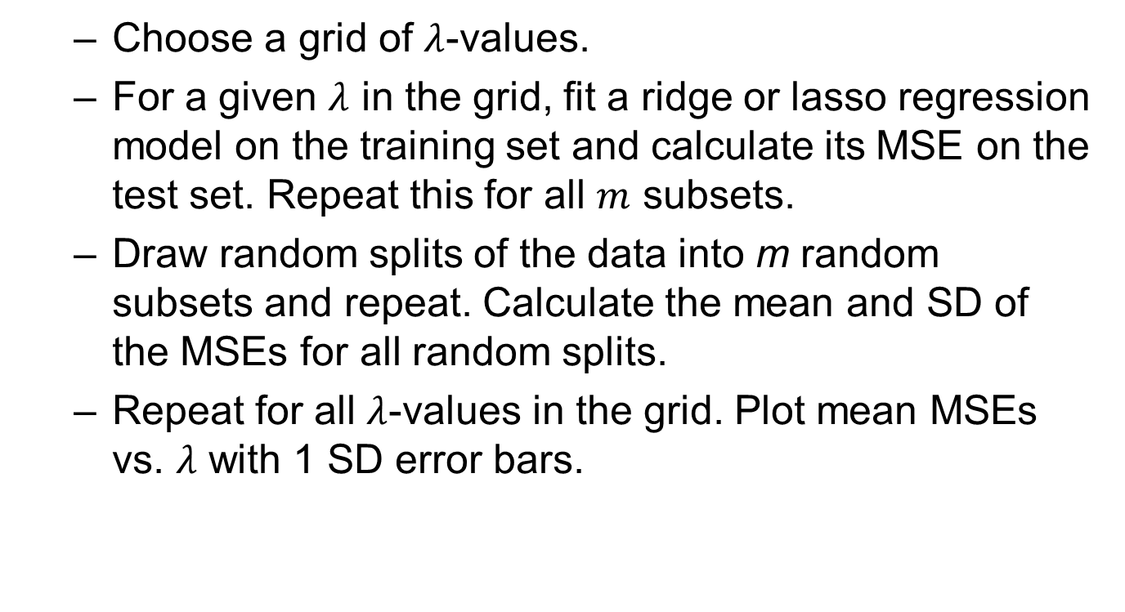

Choice of the Tuning Parameter $λ$
Choose a grid of $λ$-values.
For a given $λ$ in the grid, fit a ridge or lasso regression model on the training set and calculate its MSE on the test set. Repeat this for all $m$ subsets.
Draw random splits of the data into m random subsets and repeat. Calculate the mean and SD of the MSEs for all random splits.
Repeat for all $λ$-values in the grid. Plot mean MSEs vs. $λ$ with 1 SD error bars.

Slide 12
Hald Cement Data: R Script for Ridge Regression
> library(glmnet)
> cement=read.csv("c:/data/cement.csv")
> y=cement$y
> x=model.matrix(y~.,cement)
> ridgefit=glmnet(x, y, alpha=0,lambda=seq(0,5,0.0001))
> set.seed(123456789)
> ridgecv=cv.glmnet(x, y, alpha=0, lambda=seq(0,5,0.001), nfold=3)
> lambdaridge=ridgecv$lambda.min
> print(lambdaridge)
[1] 0.563

Slide 13
Hald Cement Data: R Script for Ridge Regression
> plot(ridgecv)
> plot(ridgefit,xvar="lambda", main="Coeffs of Ridge Regression", type="l", xlab=expression("log_lambda"), ylab="Coeff")
> abline(h=0); abline(v=log(ridgecv$lambda.min))
> small.lambda.index <- which(ridgecv$lambda == ridgecv$lambda.min)
> small.lambda.betas <- coef(ridgecv$glmnet.fit)[,small.lambda.index]
> print(small.lambda.betas)
(Intercept) (Intercept) x1 x2 x3 x4
85.4819340 0.0000000 1.2175599 0.2886873 -0.2012739 -0.3558764

Slide 14
Hald Cement Data: Ridge Trace Plot

Slide 15

Hald Cement Data: MSE Plot for Choosing $λ$ for Ridge Regression

Slide 16
Hald Cement Data: Lasso Trace Plot

Slide 17

Hald Cement Data: MSE Plot for Choosing $λ$ for Lasso Regression

Slide 18
Hald Cement Data: R Script for Lasso Regression
> library(glmnet)
> cement=read.csv("c:/data/cement.csv")
> y=cement$y
> x=model.matrix(y~.,cement)
> lassofit=glmnet(x, y, alpha=1,lambda=seq(0,5,0.0001))
> set.seed(123456789)
> lassocv=cv.glmnet(x, y, alpha=1,lambda=seq(0,5,0.001),nfold=3)
> lambdalasso=lassocv$lambda.min
> print(lambdalasso)
[1] 0.475

Slide 19
Hald Cement Data: R Script for Lasso Regression
> plot(lassocv)
> plot(lassofit,xvar="lambda", main="Coeffs of Lasso Regression",type="l", xlab=expression("log_lambda"), ylab="Coeff")
> abline(h=0); abline(v=log(lassocv$lambda.min))
> small.lambda.index <- which(lassocv$lambda == lassocv$lambda.min)
> small.lambda.betas <- coef(lassocv$glmnet.fit)[,small.lambda.index]
> print(small.lambda.betas)
(Intercept)(Intercept) x1 x2 x3 x4
72.9686274 0.0000000 1.3845859 0.3959175 0.0000000 -0.2313881

Slide 20
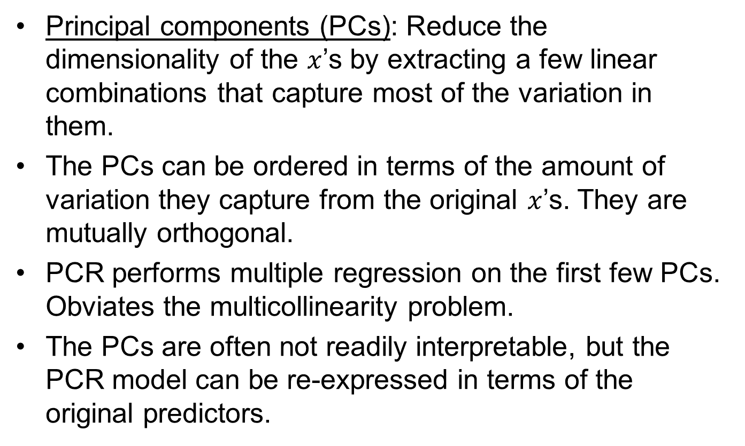
Principal Components Regression (PCR)
Principal components (PCs): Reduce the dimensionality of the $x$’s by extracting a few linear combinations that capture most of the variation in them.
The PCs can be ordered in terms of the amount of variation they capture from the original $x$’s. They are mutually orthogonal.
PCR performs multiple regression on the first few PCs. Obviates the multicollinearity problem.
The PCs are often not readily interpretable, but the PCR model can be re-expressed in terms of the original predictors.

Slide 21
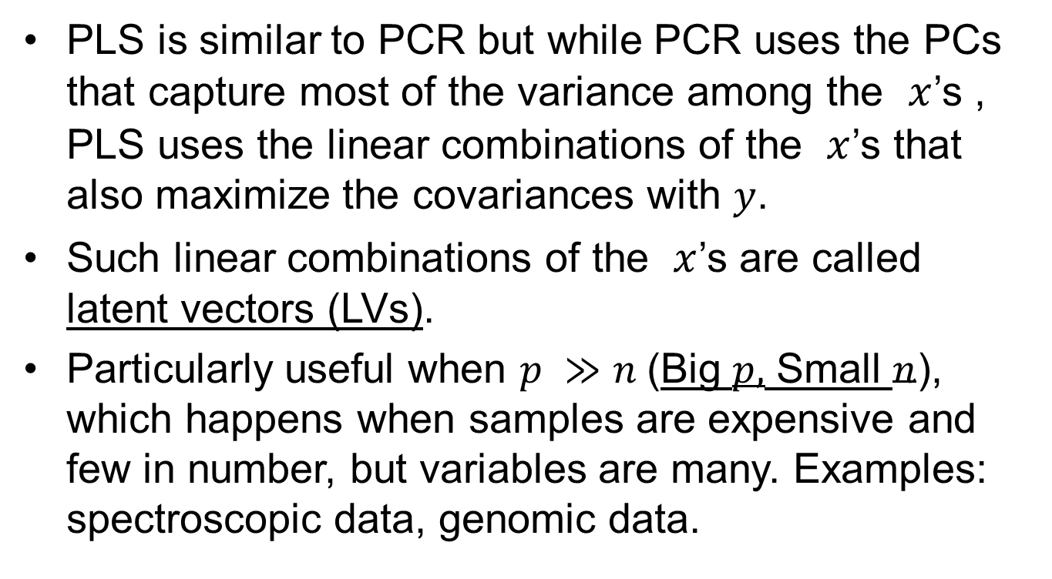
Partial Least Squares (PLS)
PLS is similar to PCR but while PCR uses the PCs that capture most of the variance among the $x$’s , PLS uses the linear combinations of the $x$’s that also maximize the covariances with $y$.
Such linear combinations of the $x$’s are called latent vectors (LVs).
Particularly useful when $p ≫n$(Big $p,$ Small $n$), which happens when samples are expensive and few in number, but variables are many. Examples: spectroscopic data, genomic data.

